Slide 1

CSE3251
Computer Networks
(Session 2018-19)
Dr. Asif Zaman
Associate Professor, CSE, RU

Slide 2
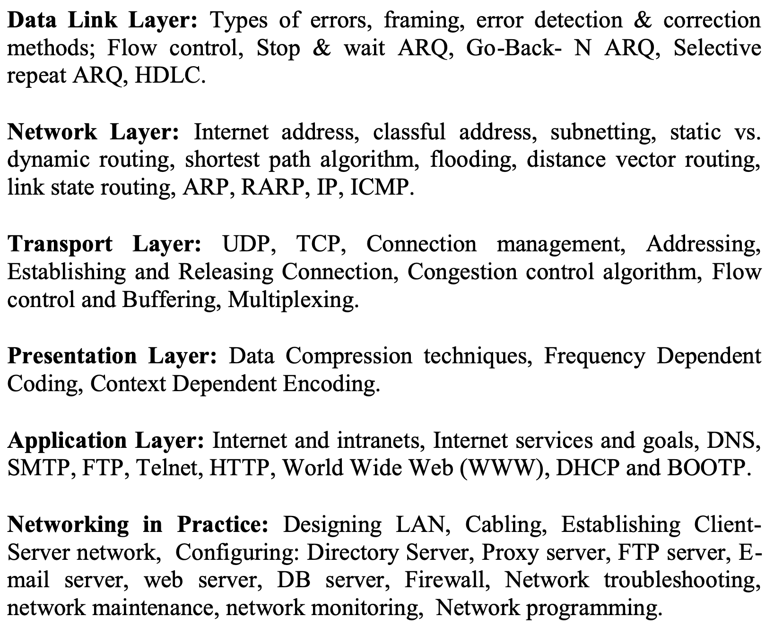
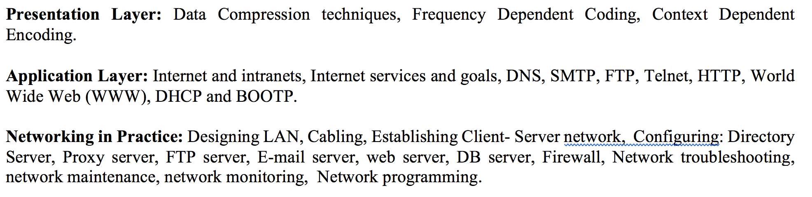
Contents

Slide 3
Transport Layer

Slide 4
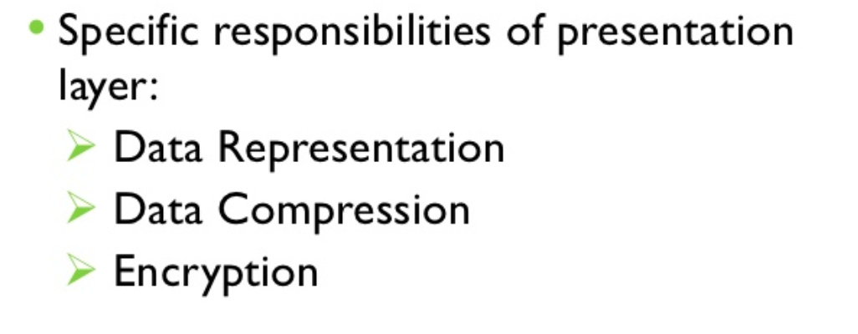
Presentation Layer
Source:
http://ecomputernotes.com/computer-graphics/basic-of-computer-graphics/data-compression

Slide 5
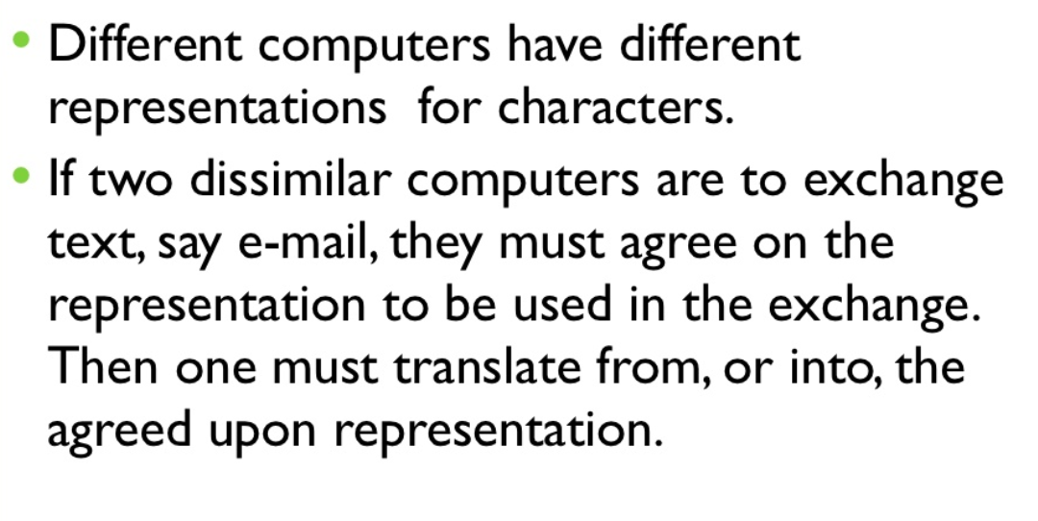
Data Representation

Slide 6
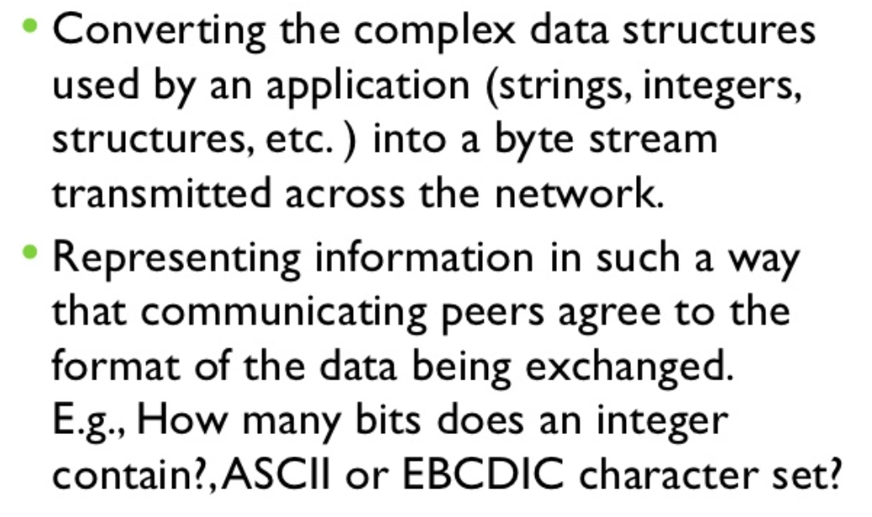
Data Representation

Slide 7
Data Compression
Compression is often used to maximize the use of bandwidth across a network or to optimize disk space when saving data.

Slide 8
Lossless Compression
Lossless compression compresses the data in such a way that when data is decompressed it is exactly the same as it was before compression i.e. there is no loss of data.
… is used to compress file data such as:
executable code,
text files, and
numeric data, because programs that process such file data cannot tolerate mistakes in the data.
… will typically not compress file as much as lossy compression techniques and may take more processing power to accomplish the compression.

Slide 9
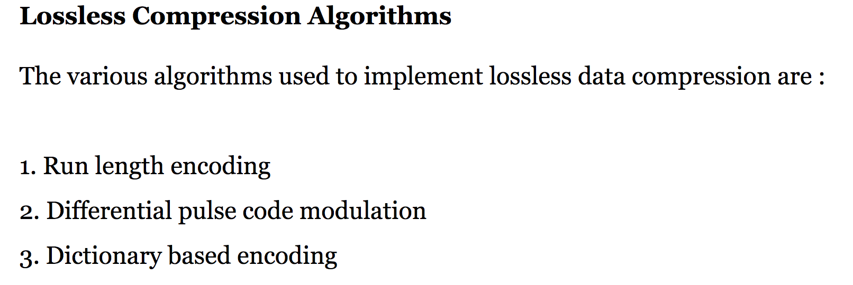
Lossless Compression

Slide 10
Run length encoding
This method replaces the consecutive occurrences of a given symbol with only one copy of the symbol along with a count of how many times that symbol occurs. Hence the names ‘run length'.
the string AAABBCDDDD would be encoded as 3A2BIC4D.
A real life example where run-length encoding is quite effective is the fax machine.
This method of compression must be used carefully. If there is not a lot of repetition in the data then it is possible the run length encoding scheme would actually increase the size of a file.

Slide 11
Differential pulse code modulation
• In this method first a reference symbol is placed. Then for each symbol in the data, we place the difference between that symbol and the reference symbol used.
For example, using symbol A as reference symbol, the string AAABBCDDDD would be encoded as AOOO1123333, since A is the same as reference symbol, B has a difference of 1 from the reference symbol and so on.

Slide 12
Dictionary based encoding
One of the best known dictionary based encoding algorithms is Lempel-Ziv (LZ) compression algorithm.
This method is also known as substitution coder.
In this method, a dictionary (table) of variable length strings (common phrases) is built.
This dictionary contains almost every string that is expected to occur in data. When any of these strings occur in the data, then they are replaced with the corresponding index to the dictionary.
For example, let us say that the word "compression" has the index 4978 in one particular dictionary; it is the 4978thword is usr/share/dict/words. To compress a body of text, each time the string "compression" appears, it would be replaced by 4978.

Slide 13
Lossy Compression
Lossy compression is the one that does not promise that the data received is exactly the same as data send i.e. the data may be lost.
This is because a lossy algorithm removes information that it cannot later restore.
Lossy algorithms are used to compress still images, video and audio.
Lossy algorithms typically achieve much better compression ratios than the lossless algorithms.

Slide 14
Lossy Compression
Two types of techniques are used for audio compression:
Predictive encoding
Perceptual encoding
Predictive encoding
In predictive encoding, the differences between the samples are encoded instead of encoding all the sampled values.
This type of compression is normally used for speech.
Several standards have been defined such as GSM (13 kbps), G. 729 (8 kbps), and G.723.3 (6.4 or 5.3 kbps).

Slide 15
Perceptual encoding
Perceptual encoding is based on the science of psychoacoustics, a study of how people perceive sound.
The perceptual encoding exploits certain flaws in the human auditory system to encode a signal in such a way that it sounds the same to a human listener, even if it looks quite different on an oscilloscope.
The key property of perceptual coding is that some sounds can mask other sound.
For example, imagine that you are broadcasting a live flute concert and all of a sudden someone starts striking a hammer on a metal sheet. You will not be able to hear the flute any more. Its sound has been masked by the hammer.

Slide 17
Directory Server
In computing, directory service or name service maps the names of network resources to their respective network addresses.
It is a shared information infrastructure for locating, managing, administering and organizing everyday items and network resources, which can include volumes, folders, files, printers, users, groups, devices, telephone numbers and other objects.
A directory service is a critical component of a network operating system.
A directory server is a server which provides such a service. Each resource on the network is considered an object by the directory server.
Information about a particular resource is stored as a collection of attributes associated with that resource or object.

Slide 18
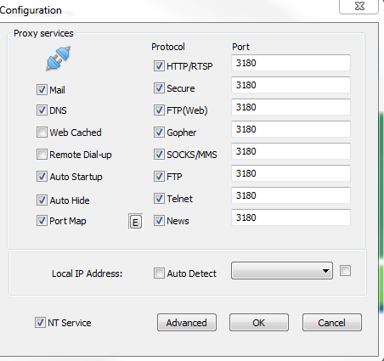
Proxy Server
Default Port: 8080

Slide 19
FTP Server
File Transfer Protocol
Default Port: 21

Slide 20
Email Server
Simple Mail Transfer Protocol (SMTP)
To Send Email
Default Port: 25

Slide 21
BootP

Slide 22
